Slide 1
Housing Project
-Nikhil Singh Rana
1

Slide 2





OUTLINE
2
◆ Tools Used
◆ Project Summary
◆ How it works ?
◆ Technology Used
◆ What it does ?

Slide 3
Introduction
Houses are one of the necessary need of each and every person around the globe and therefore housing and real estate market is one of the markets which is one of the major contributors in the world’s economy. It is a very large market and there are various companies working in the domain. Data science comes as a very important tool to solve problems in the domain to help the companies increase their overall revenue, profits, improving their marketing strategies and focusing on changing trends in house sales and purchases. Predictive modelling, Market mix modelling, recommendation systems are some of the machine learning techniques used for achieving the business goals for housing companies. Our problem is related to one such housing company. A US-based housing company named Surprise Housing has decided to enter the Australian market. The company uses data analytics to purchase houses at a price below their actual values and flip them at a higher price. For the same purpose, the company has collected a data set from the sale of houses in Australia. The data is provided in the CSV file below. The company is looking at prospective properties to buy houses to enter the market. You are required to build a model using Machine Learning in order to predict the actual value of the prospective properties and decide whether to invest in them or not. For this company wants to know: • Which variables are important to predict the price of variable? • How do these variables describe the price of the house?
3

Slide 4
Project Summary
5
Business Goal:
You are required to model the price of houses with the available independent variables. This model will then be used by the management to understand how exactly the prices vary with the variables. They can accordingly manipulate the strategy of the firm and concentrate on areas that will yield high returns. Further, the model will be a good way for the management to understand the pricing dynamics of a new market.

Slide 5
5
Technical Requirements:
• Data contains 1460 entries each having 81 variables.
• Data contains Null values. You need to treat them using the domain knowledge and your own understanding.
• Extensive EDA has to be performed to gain relationships of important variable and price.
• Data contains numerical as well as categorical variable. You need to handle them accordingly.
• You have to build Machine Learning models, apply regularization and determine the optimal values of Hyper Parameters.
• You need to find important features which affect the price positively or negatively.
• Two datasets are being provided to you (test.csv, train.csv). You will train on train.csv dataset and predict on test.csv file.

Slide 6
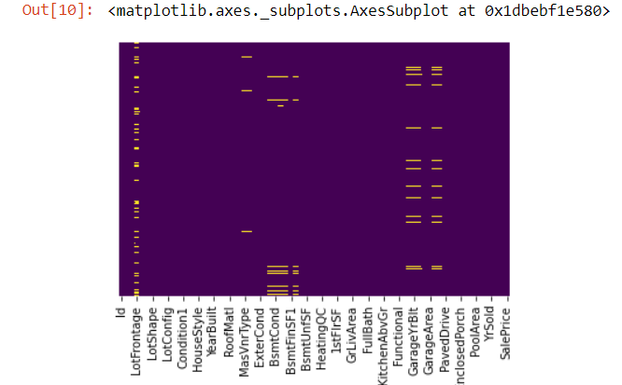
EDA Process:
1. Data Cleaning :
- Firstly we will Check if there is any NaN values and if any columns has more than 50% of the Nan values then we will Drop that Columns

Slide 7
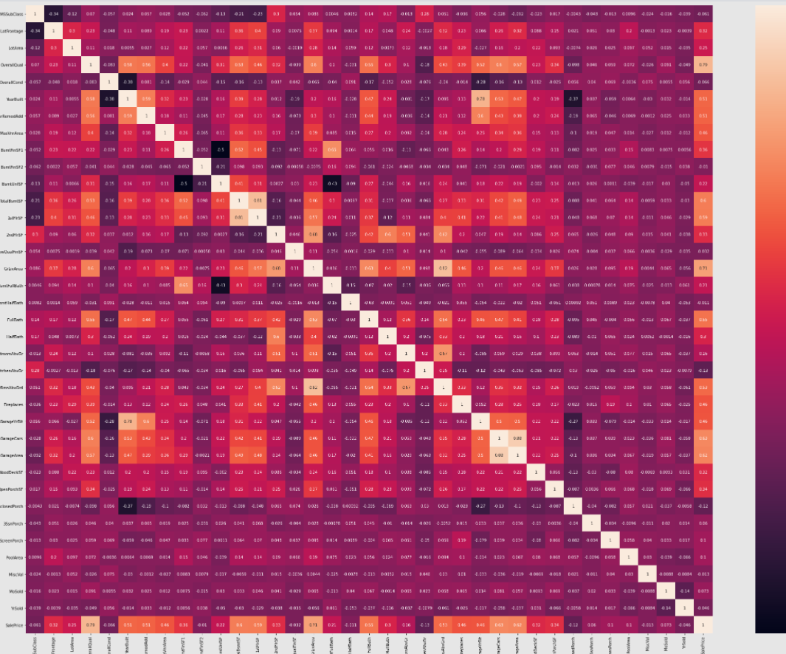
Then we will check the correlations between all the columns and remove the columns which have high correlation:

Slide 8
2. Handling Categorical Columns:
Following techniques is used to Handle the categorical Columns and to
encode them:
KNN Imputer
Feature Scaling
Label Encoder

Slide 9
Visualization :
1. Dtale Library:
For Visualization purpose here we are using Dtale library which is present in the Pandas, With the help of this library we can visualize various charts and get lot of insight from the Dataset as follows:
Find the outlier
Find correlations
Ploting Different Charts
-Describe
Insights of the each Column

Slide 10
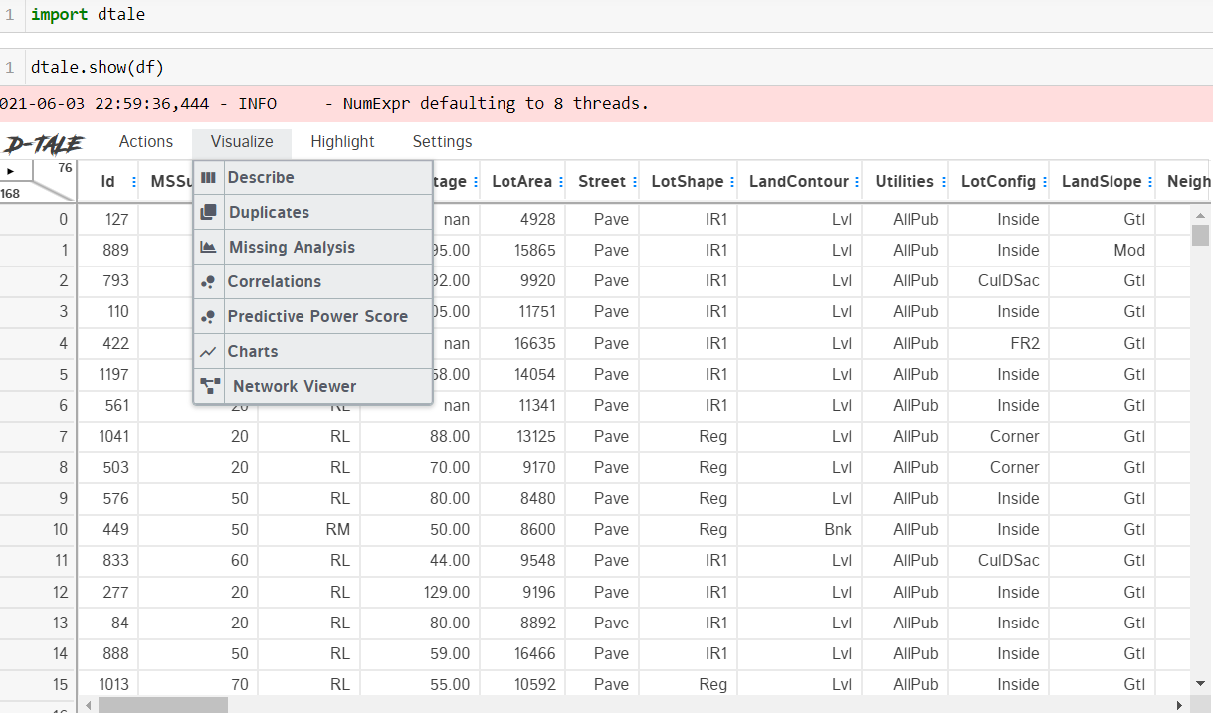
Following is the Dtale dataset view:

Slide 11
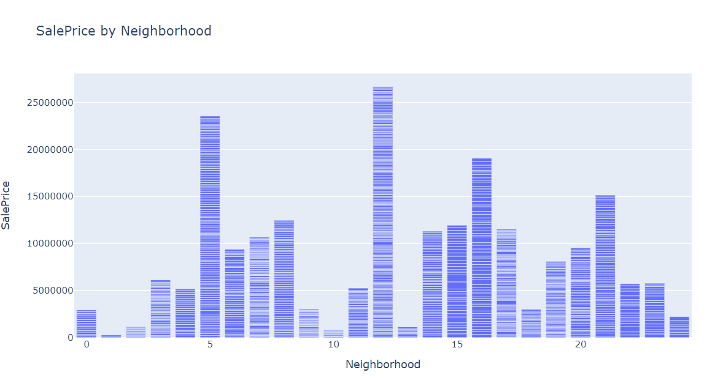
Visualisation done through Dtale :
- Here we can see the relation between sale price and neighborhood.

Slide 12
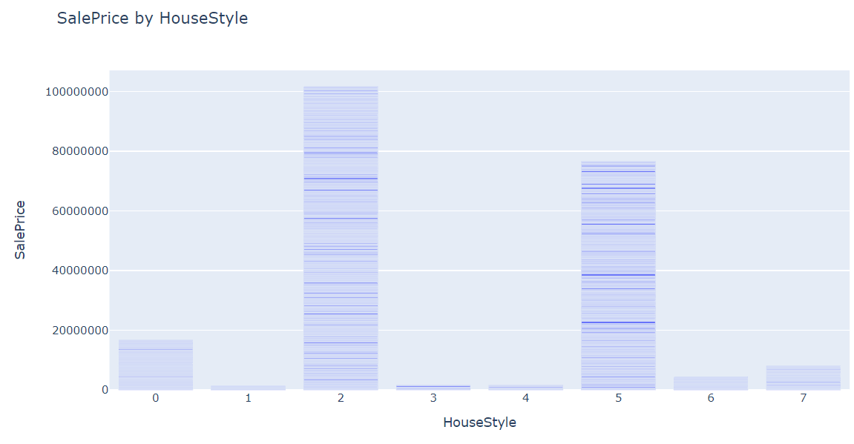
- Here we can see the relation between sale price and house style, similarly we can see the relationship between different columns.

Slide 13
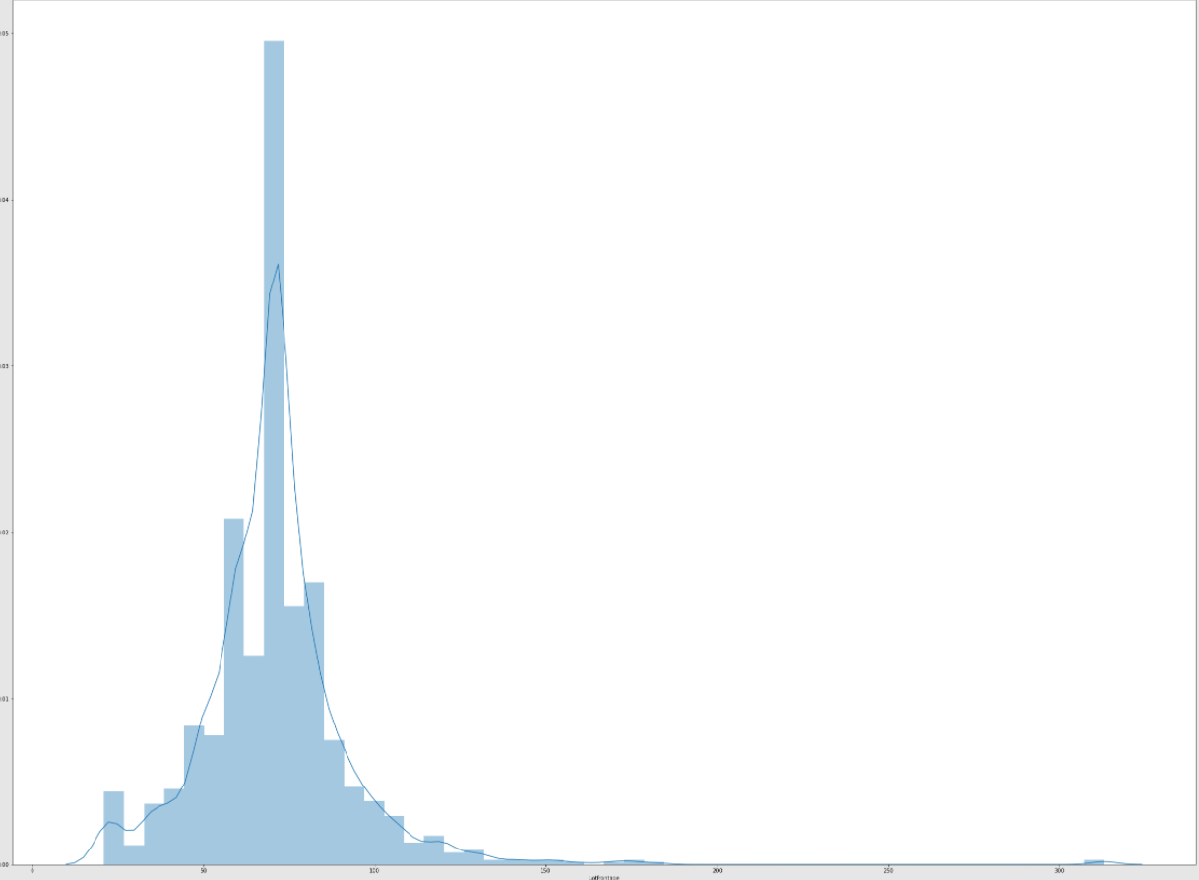
2. Checking the Skewness :
- This is the skewness of the column LotFrontage, Similarly we can check it for the others

Slide 14

3. Feature Importance :
Here we can see the top 10 Important features :

Slide 15
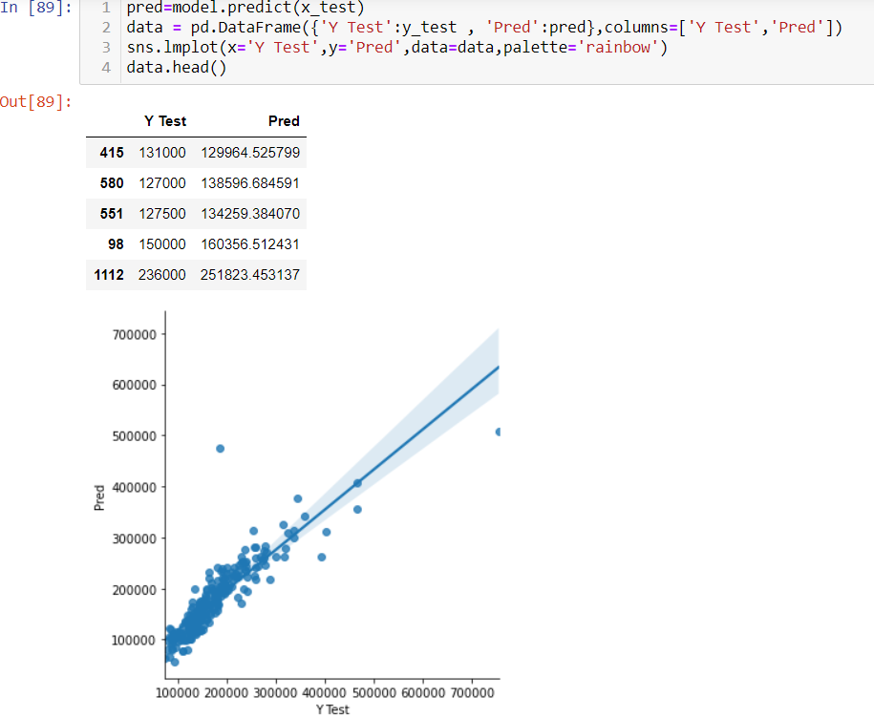
4. Accuracy of the Model and the Predicted results :

